Slide 1
Agile Project Simulation – Task Management App
A Demo Project by Rashmi Swamy

Slide 2
Introduction
Objective: Showcase end-to-end Agile project flow
Tools used: Trello, Google AI Studio, MS Word, MS PowerPoint
Outcome: Designed a 2-sprint demo project with prototype screens

Slide 3
Project Objectives
Understand Agile methodology (Scrum framework)
Manage tasks using Trello board (Backlog → Sprint → Done)
Conduct simulated Sprint Planning & Retrospective
Build demo prototype (9 screens of Task App)
Present final outcomes professionally

Slide 4
Tools Used
Trello → Agile board for sprints
Google AI Studio → Prototype screen design
MS Word → Sprint reports & notes
MS PowerPoint Final project presentation

Slide 5
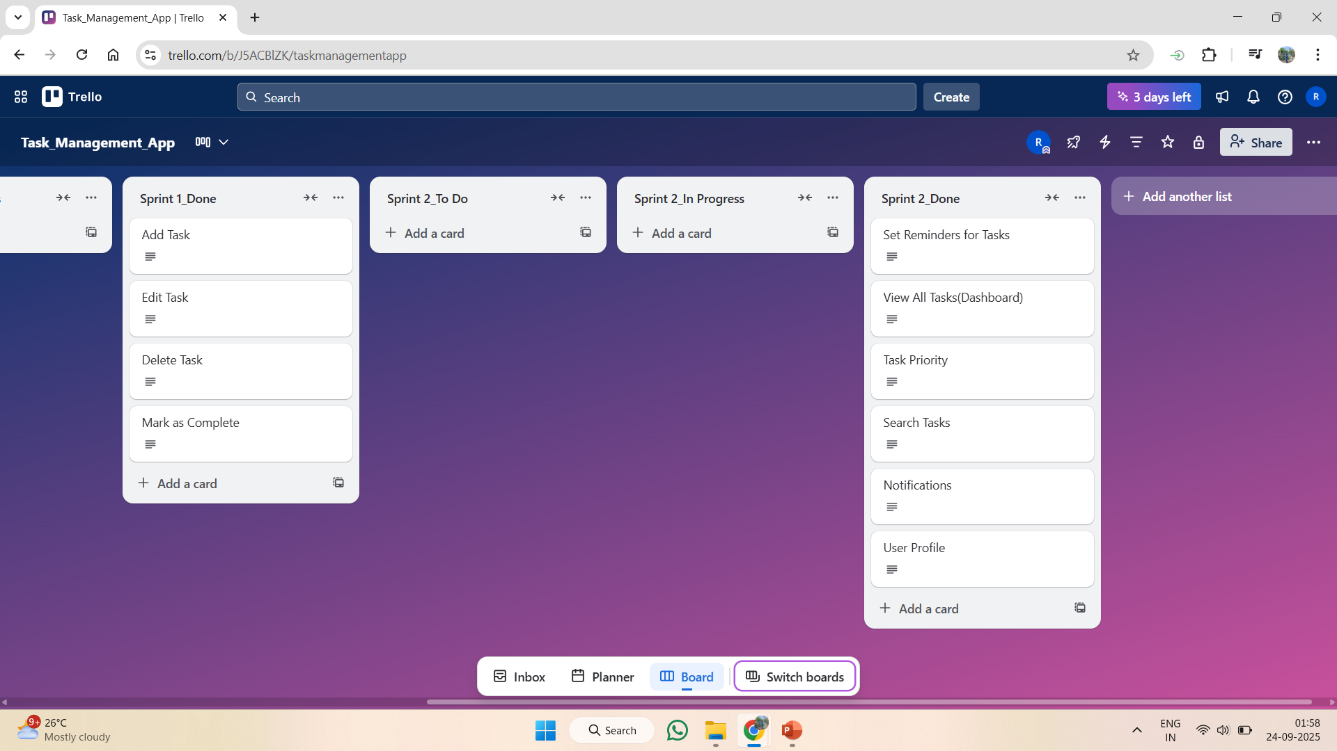
Agile Workflow
Backlog → Sprint 1 → Sprint 2 → Done
Each user story tracked through Agile lifecycle

Slide 6
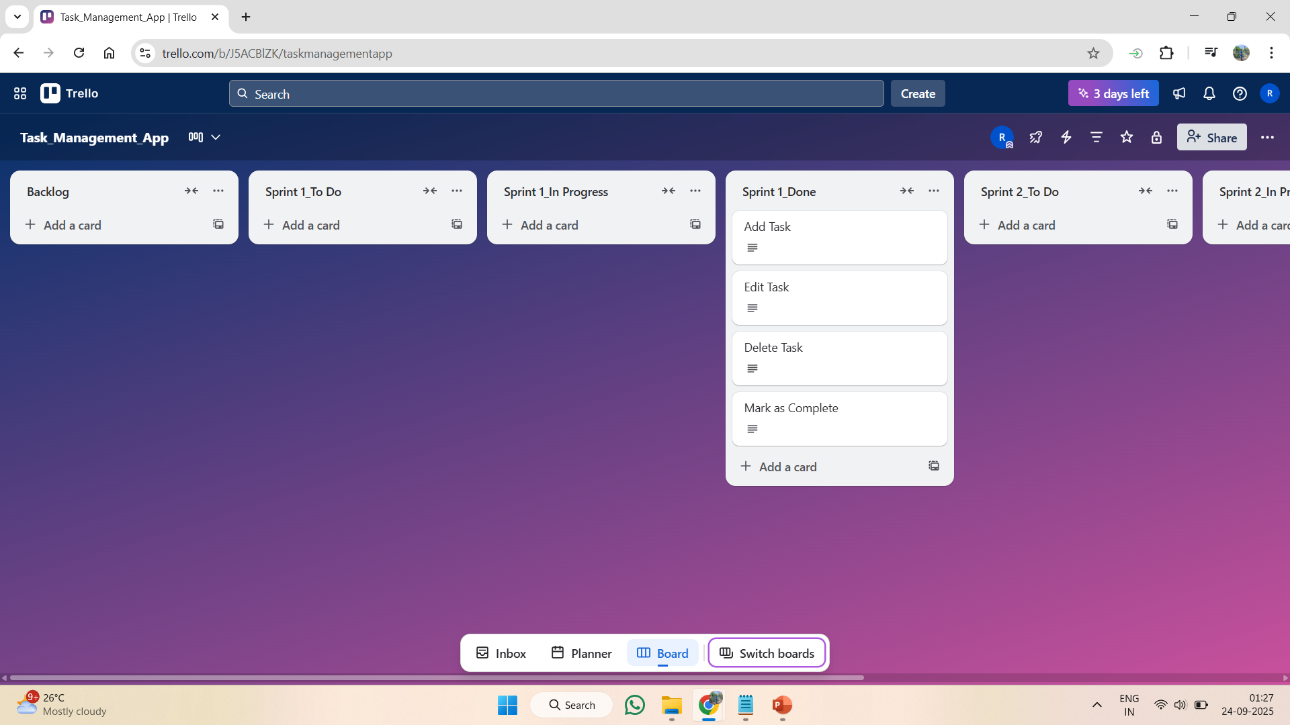
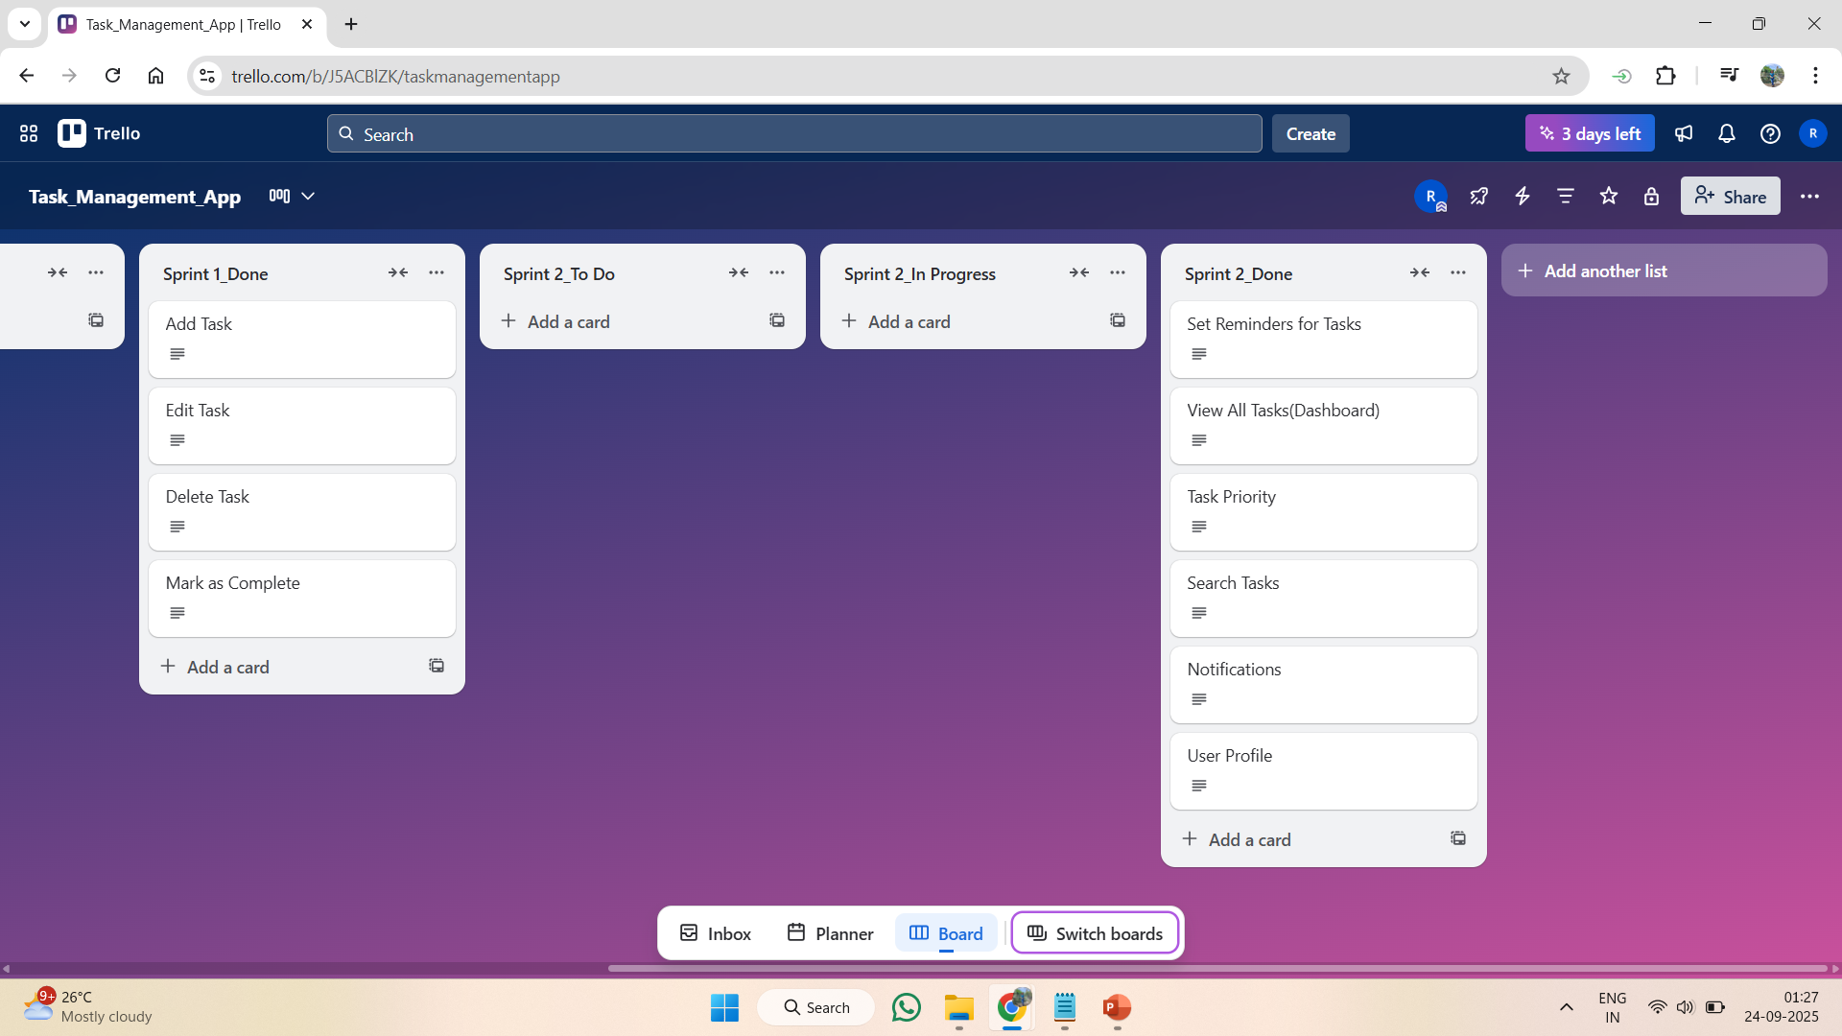

Slide 7
Sprint 1 – Planning & Execution
Focus: Login, Signup, Dashboard
Tasks moved from Backlog → Sprint 1
All tasks marked Done in Trello

Slide 8
Sprint 1 – Retrospective
✅ Achievements: Basic app flow ready (Login → Dashboard)
⚡ Improvements: Better UI consistency
📚 Learnings: Importance of prioritizing MVP features

Slide 9
Sprint 2 – Planning & Execution
Focus: Add Task, Edit Task, Analytics Dashboard
Sprint 2 tasks executed & marked Done

Slide 10
Sprint 2 – Retrospective
✅ Achievements: Full task flow simulated
⚡ Improvements: Need clickable prototype in future
📚 Learnings: Agile iterative development helps refine designs

Slide 11
Prototype Screens
Show all 9 screens (1–2 per slide)
Arrange flow: Login → Signup → Dashboard → Add Task → Edit Task → Task List → Analytics → Settings → Logout

Slide 12
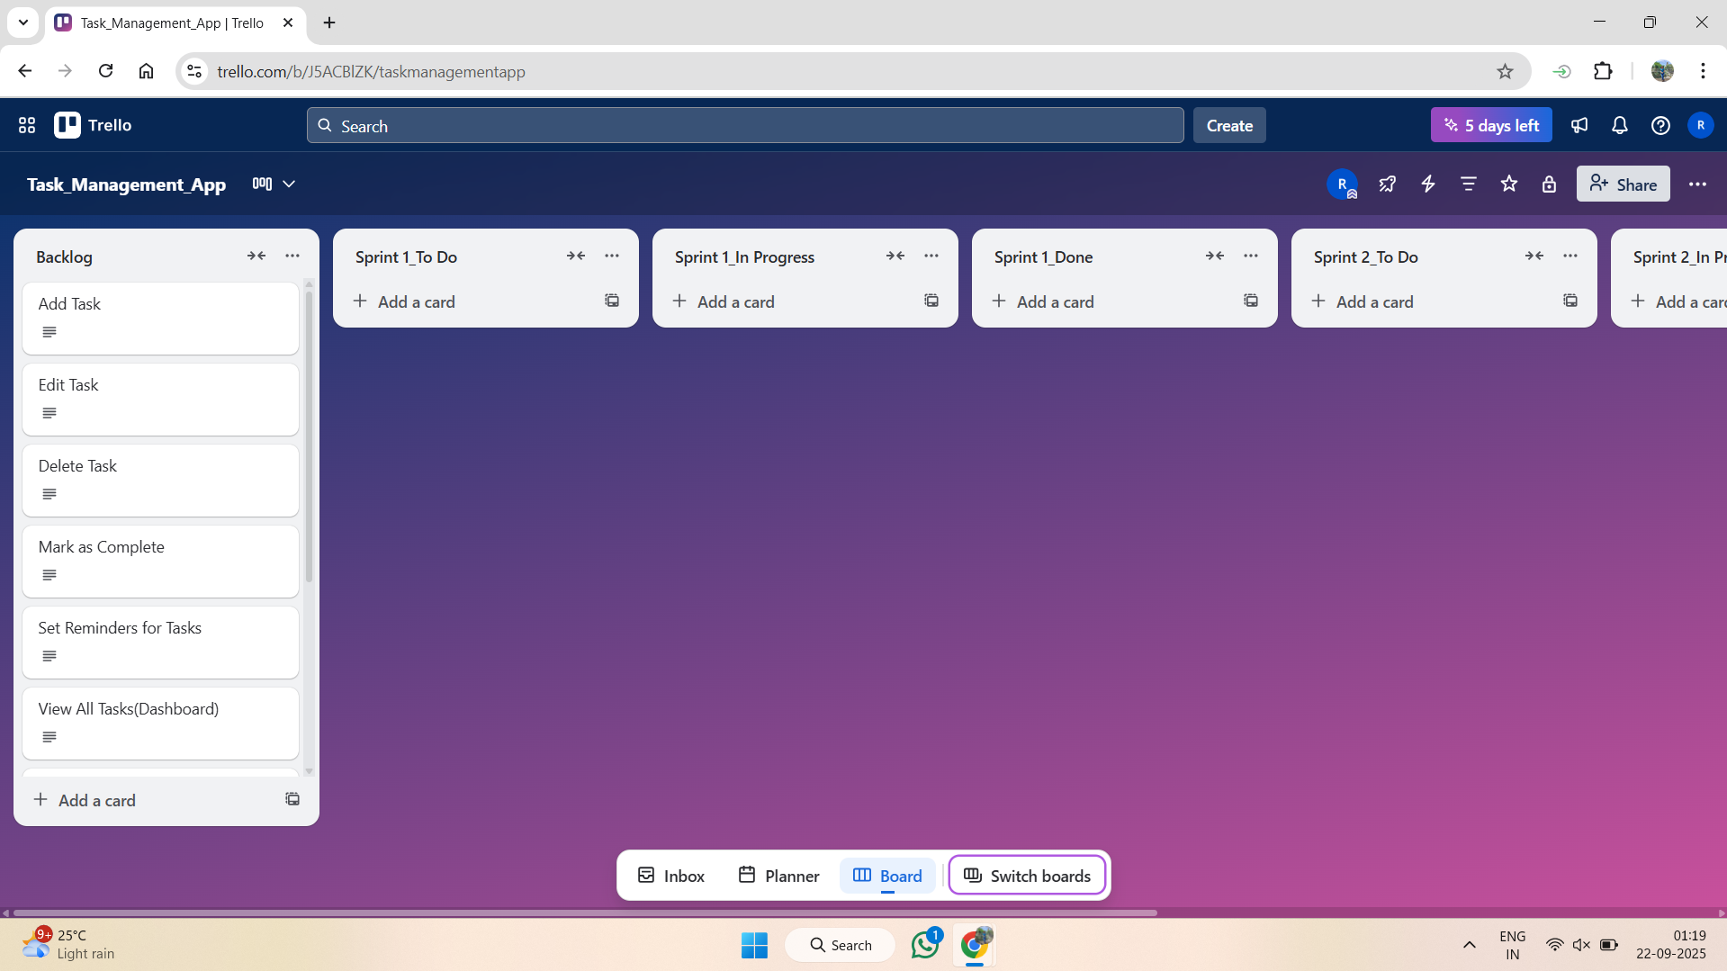
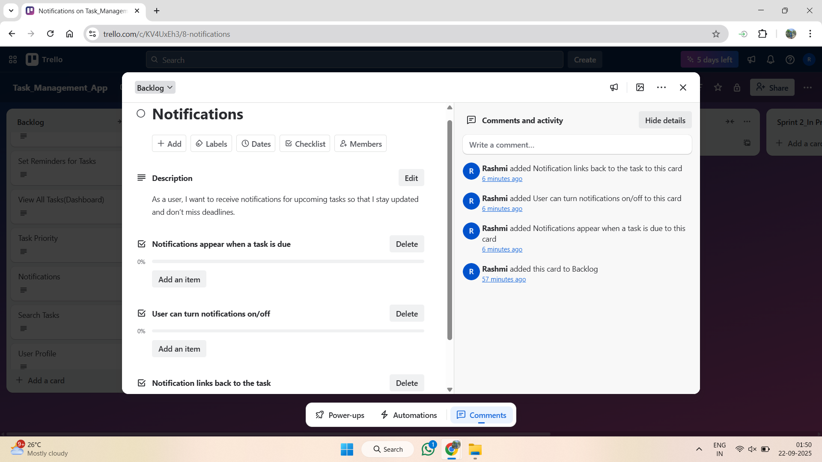

Slide 13
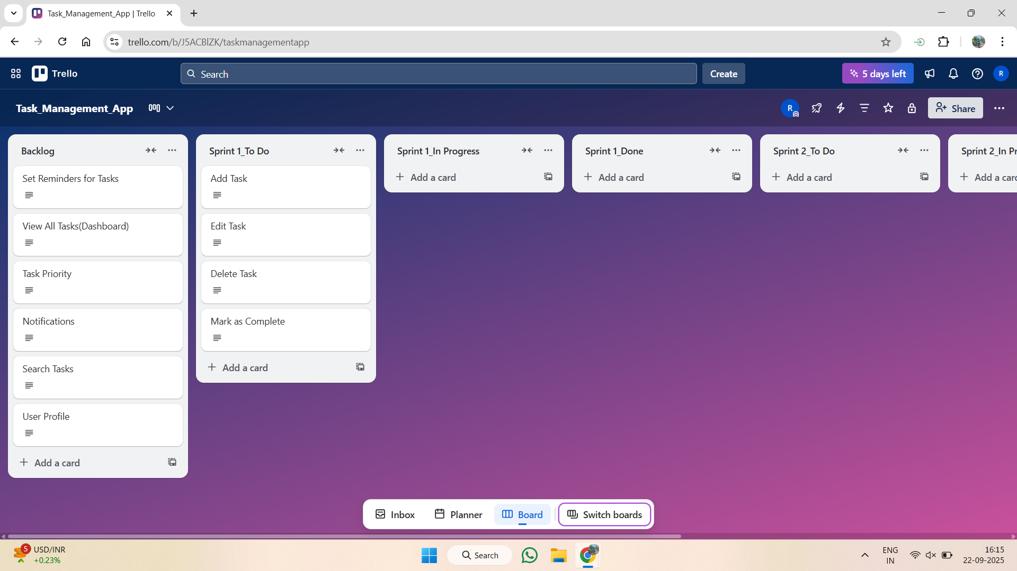
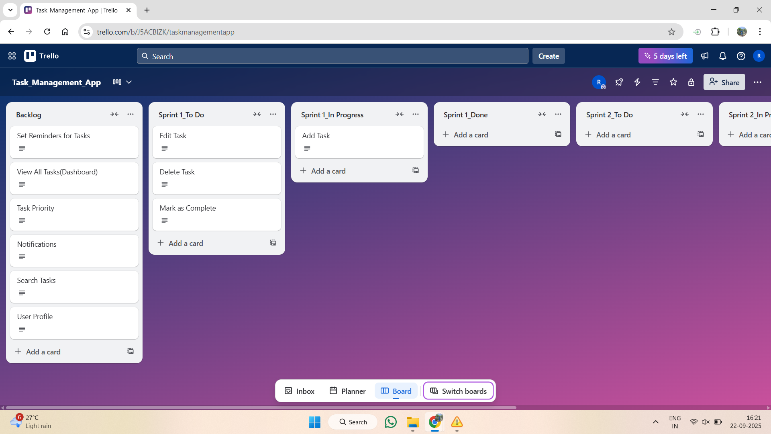

Slide 14
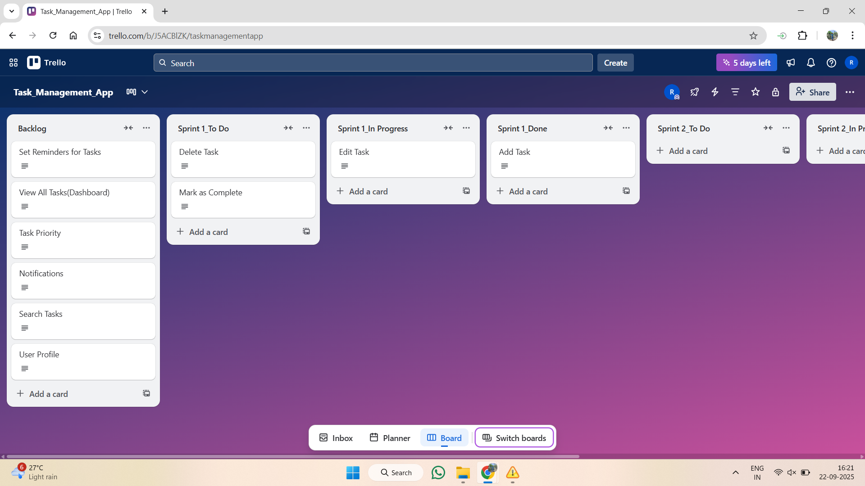
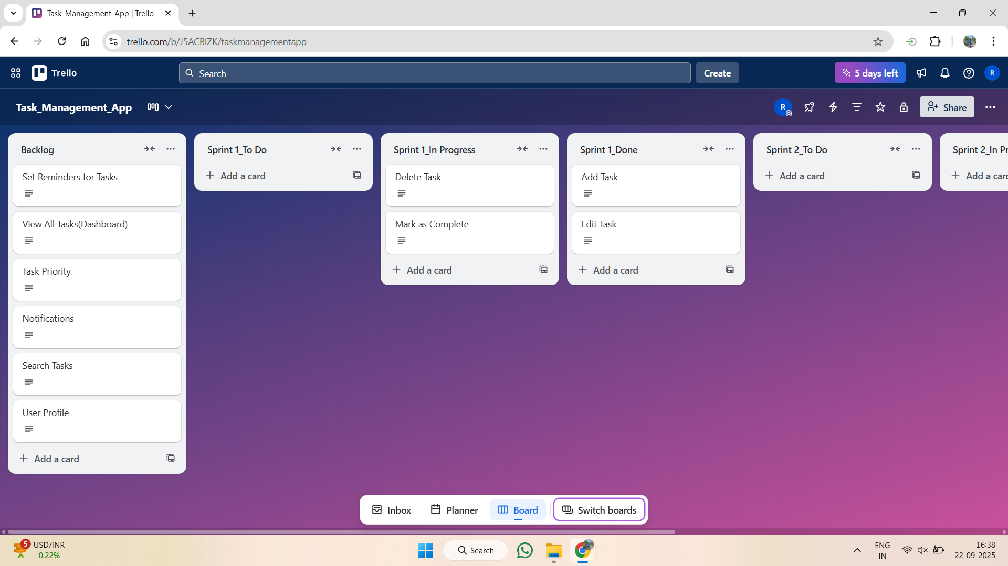

Slide 15
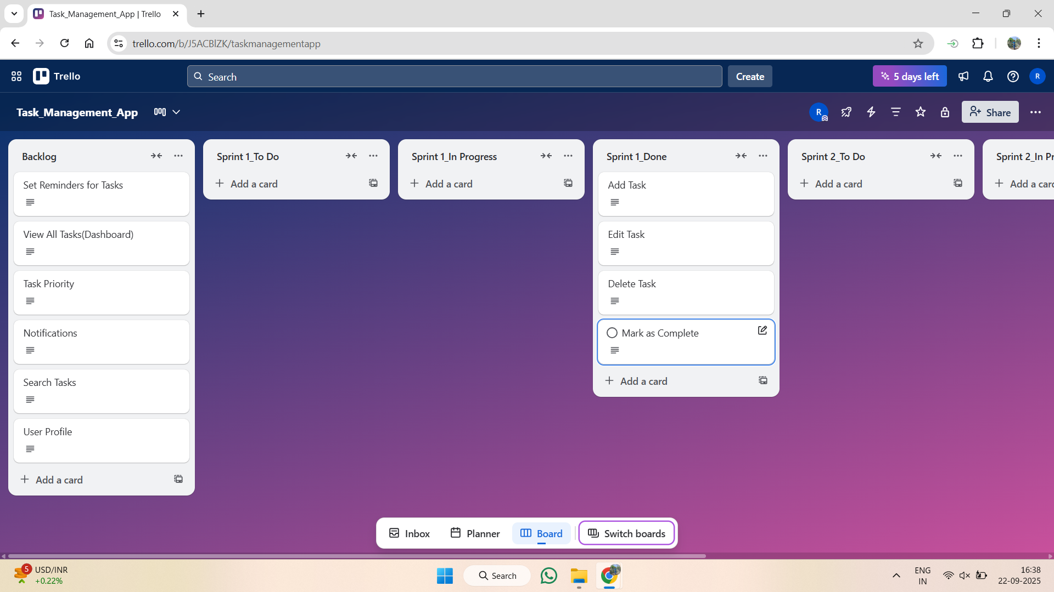
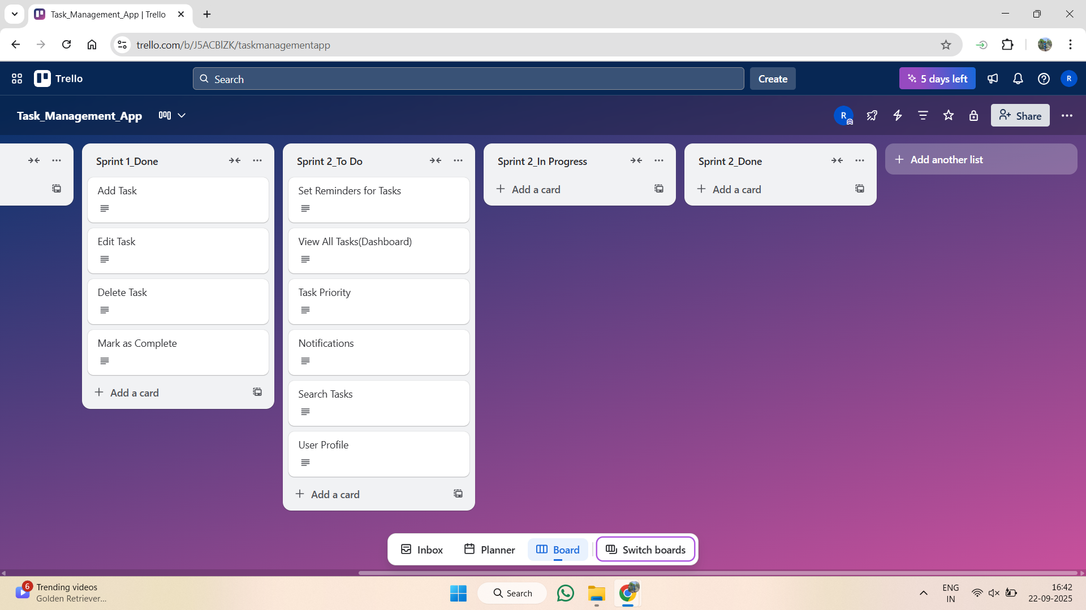

Slide 16
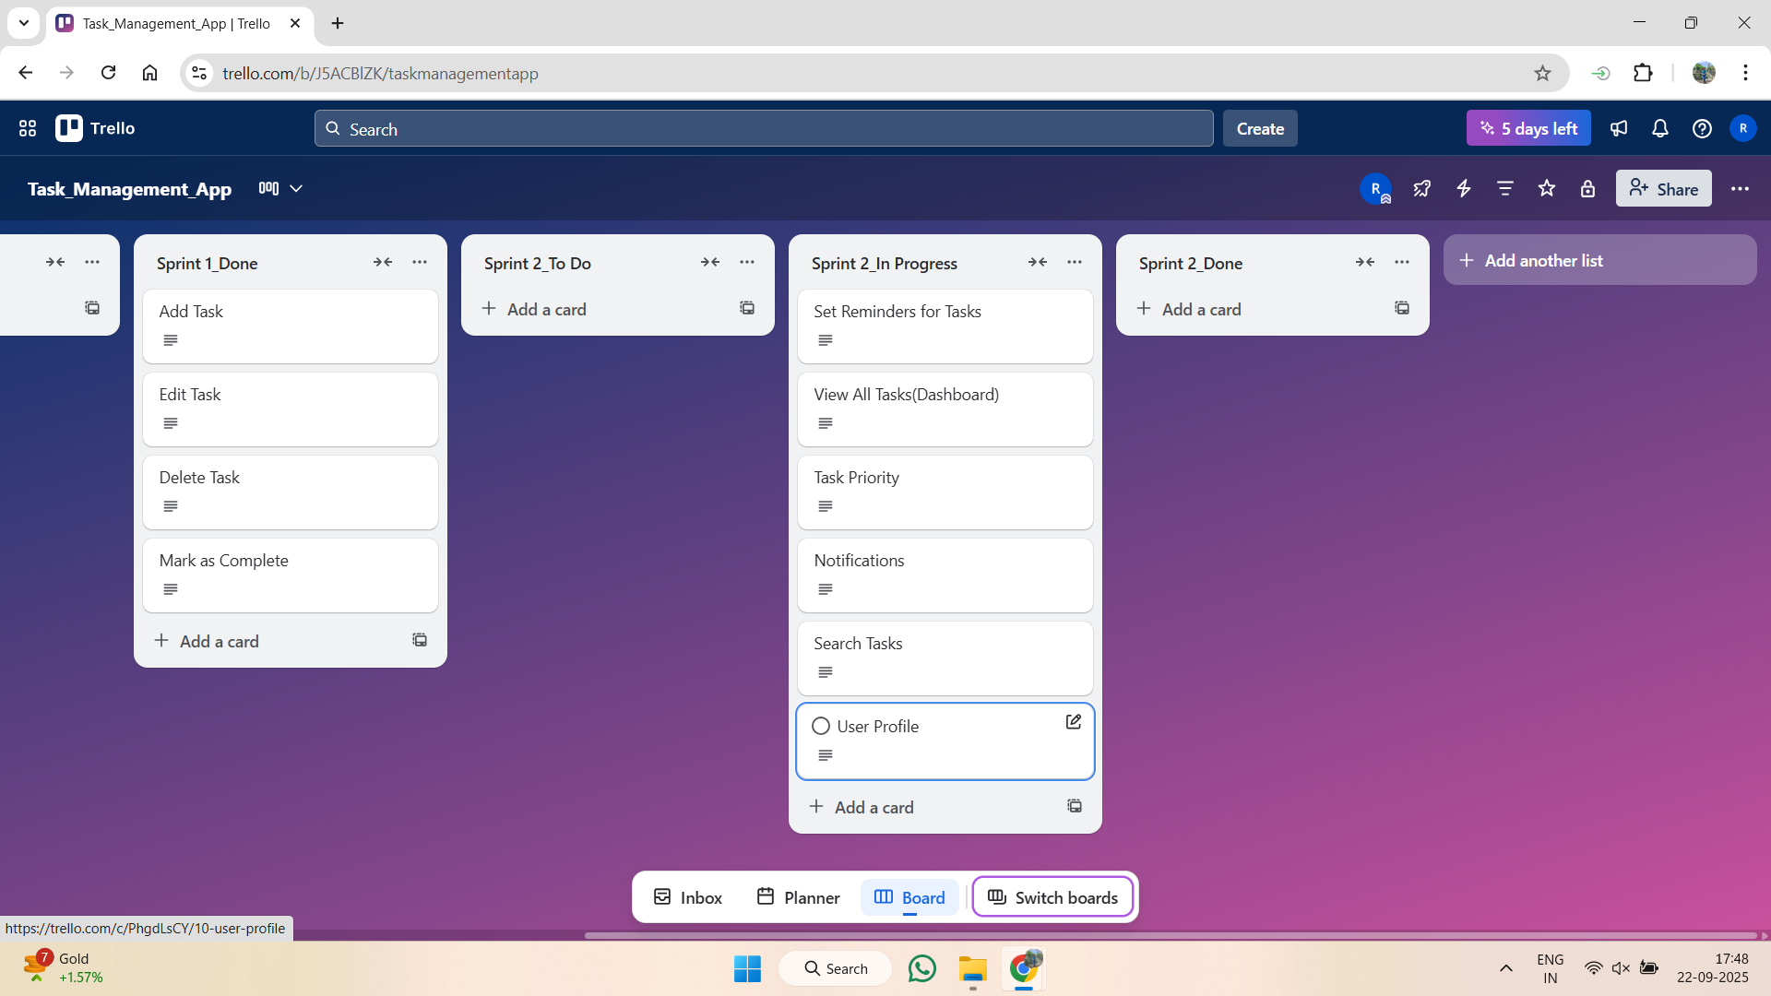
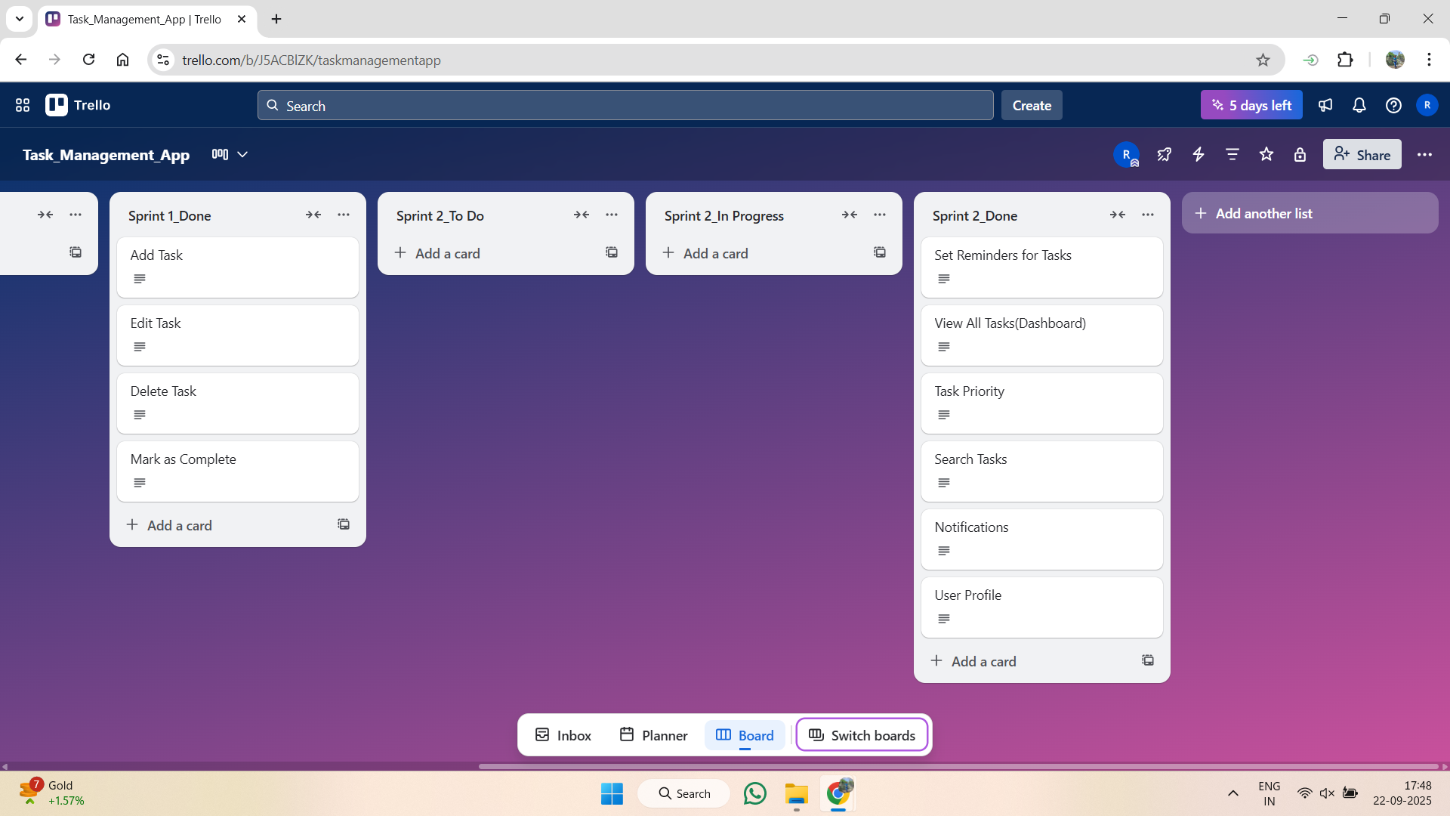

Slide 17
Conclusion
Project demonstrates knowledge of:
• Agile workflow (Sprints, Retrospectives)
• Trello for project management
• UI prototyping using AI tools

